Slide 1
GRADE 7 ACCELERATED · UNIT 4 · LESSONS 2–3
Multiplying and Dividing in Scientific Notation
MA.8.NSO.1.5
I can multiply and divide two numbers written in scientific notation, and write the answer in scientific notation.
Grade 7 Accelerated · Unit 4 · Lessons 2–3 — Multiplying and Dividing in Scientific Notation
1

Slide 2
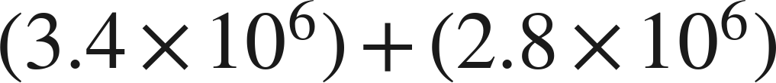
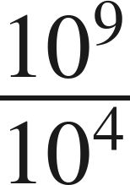
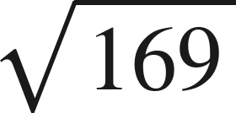
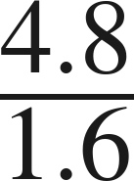
Warm-Up
1.
2. Write as one power:
3. Find the value:
4. Find the quotient:
Grade 7 Accelerated · Unit 4 · Lessons 2–3 — Multiplying and Dividing in Scientific Notation
2

Slide 3
Warm-Up
1.
6.2 × 10⁶
2. Write as one power:
10⁵
3. Find the value:
13
4. Find the quotient:
3
Grade 7 Accelerated · Unit 4 · Lessons 2–3 — Multiplying and Dividing in Scientific Notation
3

Slide 4


Notes
I. Multiplying: regroup, then use the laws
, never
Multiply the coefficients. Add the exponents — that is the product of powers law, not a new rule.
Grade 7 Accelerated · Unit 4 · Lessons 2–3 — Multiplying and Dividing in Scientific Notation
4

Slide 5
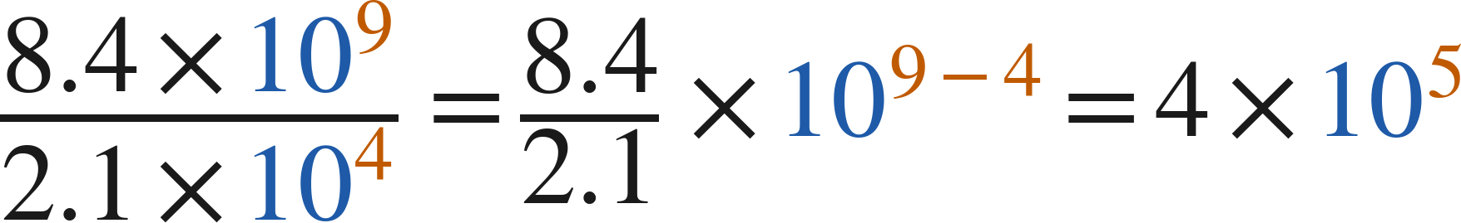
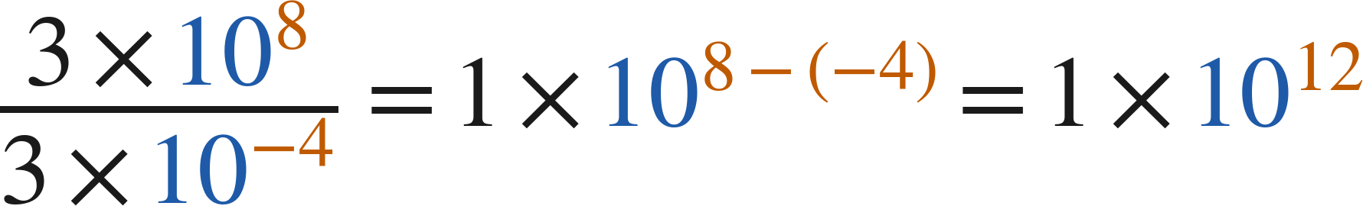
Notes
II. Dividing: the same move with the quotient law
Divide the coefficients. Subtract the exponents, top minus bottom.
Grade 7 Accelerated · Unit 4 · Lessons 2–3 — Multiplying and Dividing in Scientific Notation
5

Slide 6
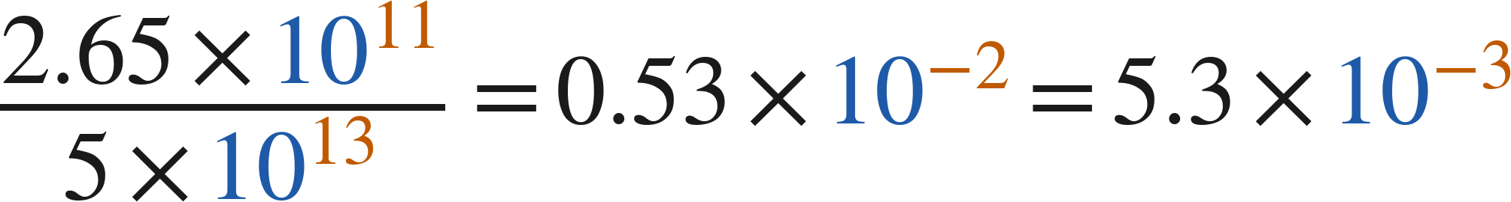
Notes
III. Finish the answer — both directions
Every answer ends with a coefficient at least 1 and less than 10.
Grade 7 Accelerated · Unit 4 · Lessons 2–3 — Multiplying and Dividing in Scientific Notation
6

Slide 7
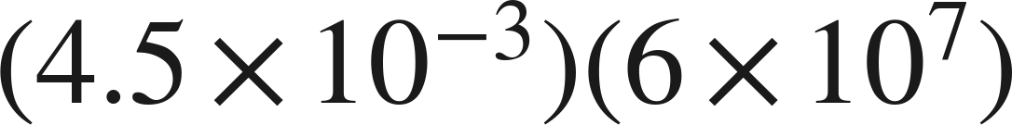
Example 1
Multiply. Write the answer in scientific notation.
Grade 7 Accelerated · Unit 4 · Lessons 2–3 — Multiplying and Dividing in Scientific Notation
7

Slide 8


Example 1
Answer: 2.7 × 10⁵
Grade 7 Accelerated · Unit 4 · Lessons 2–3 — Multiplying and Dividing in Scientific Notation
8

Slide 9
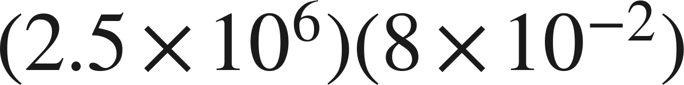
Your Turn
Multiply. Write the answer in scientific notation.
Grade 7 Accelerated · Unit 4 · Lessons 2–3 — Multiplying and Dividing in Scientific Notation
9

Slide 10
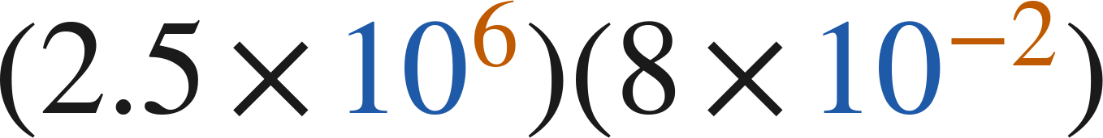
Your Turn
Multiply. Write the answer in scientific notation.
Answer: 2 × 10⁵
Grade 7 Accelerated · Unit 4 · Lessons 2–3 — Multiplying and Dividing in Scientific Notation
10

Slide 11
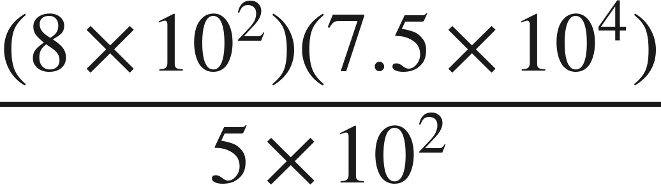
Example 2
Evaluate. Write the answer in scientific notation.
Grade 7 Accelerated · Unit 4 · Lessons 2–3 — Multiplying and Dividing in Scientific Notation
11

Slide 12
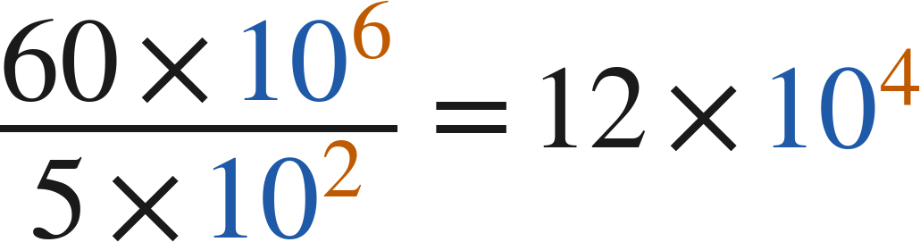

Example 2
Answer: 1.2 × 10⁵
Grade 7 Accelerated · Unit 4 · Lessons 2–3 — Multiplying and Dividing in Scientific Notation
12

Slide 13
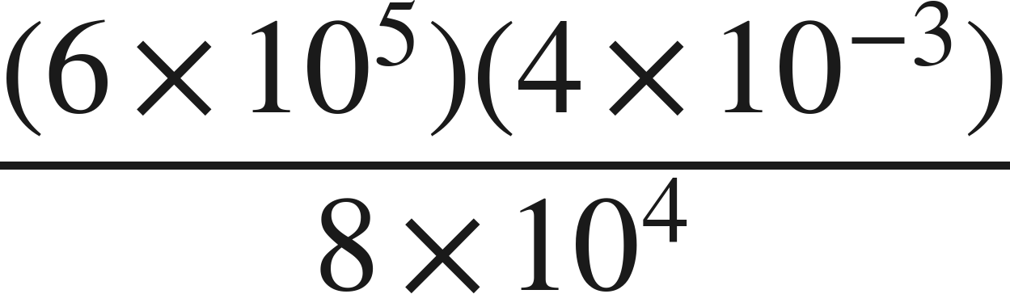
Your Turn
Evaluate. Write the answer in scientific notation.
Grade 7 Accelerated · Unit 4 · Lessons 2–3 — Multiplying and Dividing in Scientific Notation
13

Slide 14
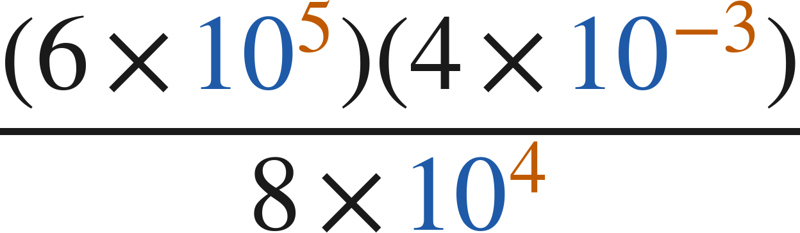
Your Turn
Evaluate. Write the answer in scientific notation.
Answer: 3 × 10⁻²
Grade 7 Accelerated · Unit 4 · Lessons 2–3 — Multiplying and Dividing in Scientific Notation
14

Slide 15
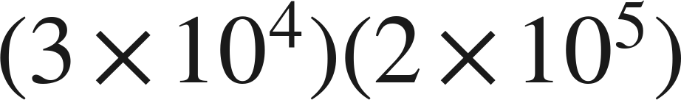
Whiteboards · Question 1 of 9
Answer it.
Grade 7 Accelerated · Unit 4 · Lessons 2–3 — Multiplying and Dividing in Scientific Notation
15

Slide 16
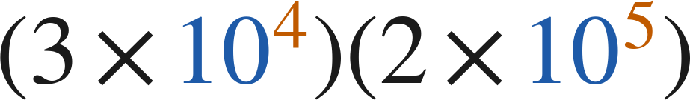
Whiteboards · Question 1 of 9
Answer: 6 × 10⁹
Grade 7 Accelerated · Unit 4 · Lessons 2–3 — Multiplying and Dividing in Scientific Notation
16

Slide 17


Whiteboards · Question 2 of 9
A printer makes
copies per hour.
It runs for
hours. Paper costs 3 cents a sheet.
How many copies does it make?
Answer it.
Grade 7 Accelerated · Unit 4 · Lessons 2–3 — Multiplying and Dividing in Scientific Notation
17

Slide 18


Whiteboards · Question 2 of 9
A printer makes
copies per hour.
It runs for
hours. Paper costs 3 cents a sheet.
How many copies does it make?
Answer: 1 × 10⁶
Grade 7 Accelerated · Unit 4 · Lessons 2–3 — Multiplying and Dividing in Scientific Notation
18

Slide 19
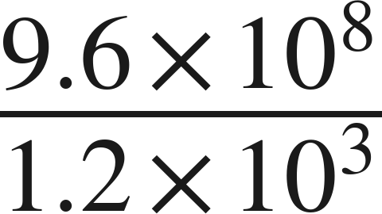
Whiteboards · Question 3 of 9
Answer it.
Grade 7 Accelerated · Unit 4 · Lessons 2–3 — Multiplying and Dividing in Scientific Notation
19

Slide 20
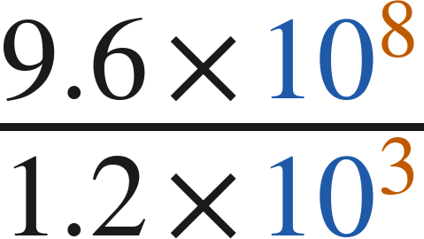
Whiteboards · Question 3 of 9
Answer: 8 × 10⁵
Grade 7 Accelerated · Unit 4 · Lessons 2–3 — Multiplying and Dividing in Scientific Notation
20

Slide 21
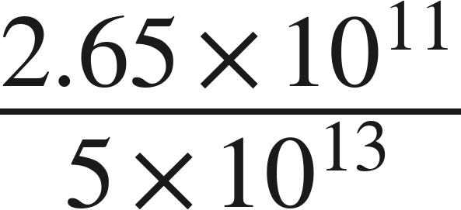
Whiteboards · Question 4 of 9
Answer it.
Grade 7 Accelerated · Unit 4 · Lessons 2–3 — Multiplying and Dividing in Scientific Notation
21

Slide 22
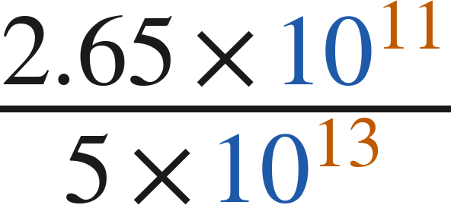
Whiteboards · Question 4 of 9
Answer: 5.3 × 10⁻³
Grade 7 Accelerated · Unit 4 · Lessons 2–3 — Multiplying and Dividing in Scientific Notation
22

Slide 23
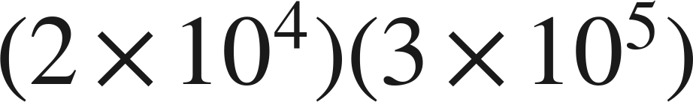
Whiteboards · Question 5 of 9
Which is the product?
A. 6 × 10⁻¹
B. 6 × 10²⁰
C. 6 × 10⁹
D. 5 × 10⁹
Answer it.
Grade 7 Accelerated · Unit 4 · Lessons 2–3 — Multiplying and Dividing in Scientific Notation
23

Slide 24
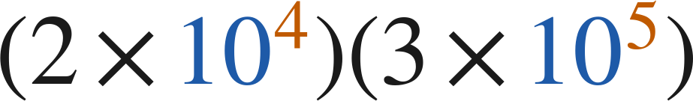
Whiteboards · Question 5 of 9
Which is the product?
A. 6 × 10⁻¹
B. 6 × 10²⁰
C. 6 × 10⁹
D. 5 × 10⁹
Answer: C — 6 × 10⁹
Grade 7 Accelerated · Unit 4 · Lessons 2–3 — Multiplying and Dividing in Scientific Notation
24

Slide 25
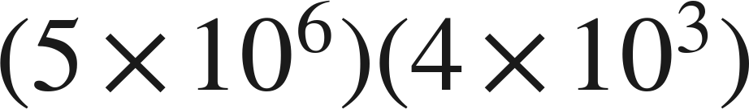
Whiteboards · Question 6 of 9
Which is the product, written in scientific notation?
A. 2 × 10⁹
B. 20 × 10⁹
C. 20 × 10¹⁸
D. 2 × 10¹⁰
Answer it.
Grade 7 Accelerated · Unit 4 · Lessons 2–3 — Multiplying and Dividing in Scientific Notation
25

Slide 26
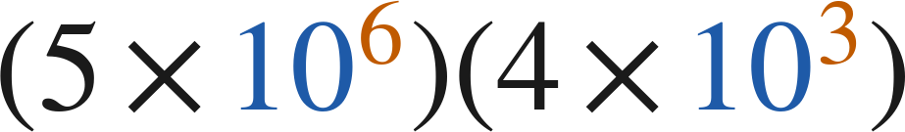
Whiteboards · Question 6 of 9
Which is the product, written in scientific notation?
A. 2 × 10⁹
B. 20 × 10⁹
C. 20 × 10¹⁸
D. 2 × 10¹⁰
Answer: D — 2 × 10¹⁰
Grade 7 Accelerated · Unit 4 · Lessons 2–3 — Multiplying and Dividing in Scientific Notation
26

Slide 27
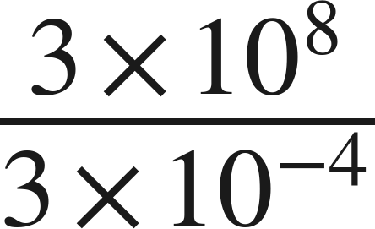
Whiteboards · Question 7 of 9
Answer it.
Grade 7 Accelerated · Unit 4 · Lessons 2–3 — Multiplying and Dividing in Scientific Notation
27

Slide 28
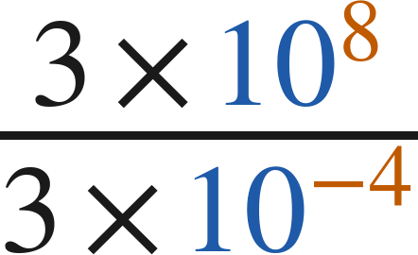
Whiteboards · Question 7 of 9
Answer: 1 × 10¹²
Grade 7 Accelerated · Unit 4 · Lessons 2–3 — Multiplying and Dividing in Scientific Notation
28

Slide 29
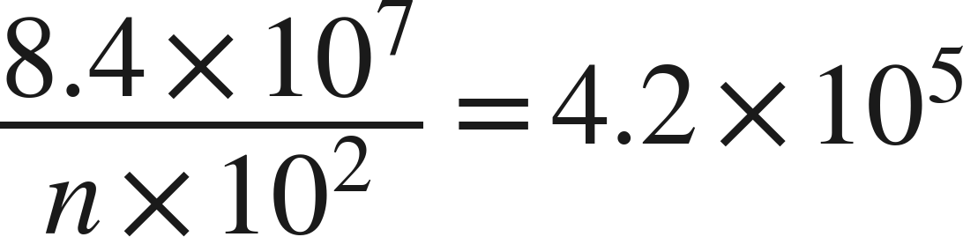

Whiteboards · Question 8 of 9
What is the value of
?
Answer it.
Grade 7 Accelerated · Unit 4 · Lessons 2–3 — Multiplying and Dividing in Scientific Notation
29

Slide 30
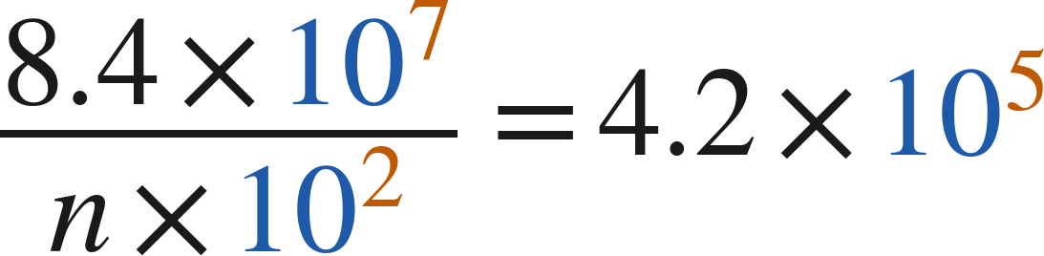
Whiteboards · Question 8 of 9
What is the value of
?
Answer: n = 2
Grade 7 Accelerated · Unit 4 · Lessons 2–3 — Multiplying and Dividing in Scientific Notation
30

Slide 31
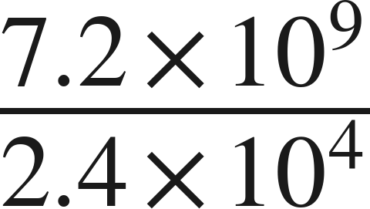
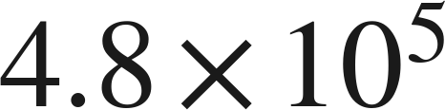
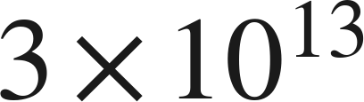
Whiteboards · Question 9 of 9
For
Marcus writes
and Sara writes
Name what each one did wrong, and give the correct quotient.
Write your answer in sentences.
Grade 7 Accelerated · Unit 4 · Lessons 2–3 — Multiplying and Dividing in Scientific Notation
31

Slide 32
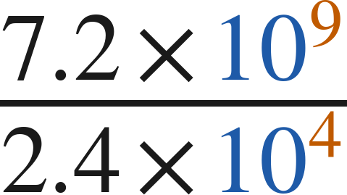
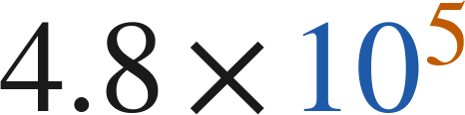
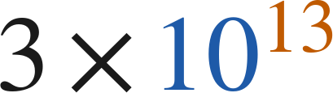
Whiteboards · Question 9 of 9
For
Marcus writes
and Sara writes
Name what each one did wrong, and give the correct quotient.
Answer: 3 × 10⁵
Grade 7 Accelerated · Unit 4 · Lessons 2–3 — Multiplying and Dividing in Scientific Notation
32

Slide 33
Independent Set
1.
Six questions. Work down the page.
2.
Show the step that does the work, not just the answer.
3.
Silence until the six minutes are up.
Grade 7 Accelerated · Unit 4 · Lessons 2–3 — Multiplying and Dividing in Scientific Notation
33

Slide 34
IXL
1.
Open IXL and start today's skills.
2.
Work on paper where the question needs work. The answer box does not show it.
3.
Every skill listed is required, to a SmartScore of 67. Due at the start of the next class.
Today's skills — all required
Multiply numbers written in scientific notation — YZU
Divide numbers written in scientific notation — SGT
Grade 7 Accelerated · Unit 4 · Lessons 2–3 — Multiplying and Dividing in Scientific Notation
34

